Slide 1

Zomato, Bangalore Data Analysis
What and where to eat in Bangalore….

Slide 2

Hello!
I am Sreya Basak
I am an aspiring Data Analyst.
I will be analyzing the Zomato restaurant data for the city, Bangalore in MySQL workbench. I have executed some queries on the database and got some business insights which I will discuss here in the following slides.

Slide 3
Roadmap to my Project
Search for a suitable dataset from KAGGLE
Save the dataset in Excel in .csv format
Import the dataset in table using Command Line Prompt
1
3
5
2
4
6
Clean the dataset and remove null values, blank rows and unnecessary columns
Create a database and table in MySQL with datatypes similar to that of the csv file
Execute the queries in MySQL workbench to get some insights about the dataset
3

Slide 4
Preface about DATASET
Bangalore is one of the most ethnically diverse cities in the country, with over 51% of the city’s population being migrants from other parts of India
Bangalore has a unique food culture. Restaurants from all over the world can be found here in Bengaluru, with various kind of cuisines. The food industry is always at a rise in Bangalore, with 12,000 plus restaurants currently active in the city, the number is still increasing.
The growing number of restaurants and dishes in Bangalore is what attracts me to inspect the data to get some insights, some interesting facts and figures.
So, in this project I will be working on 19,118 rows of data.

Slide 5

Attributes of the Dataset
The dataset is taken from Kaggle. It contains the following features :
name : This feature contains the name of the restaurant
online_order : whether online ordering is available in the restaurant or not
book_table : table book option available or not
rate : contains the overall rating of the restaurant out of 5
votes : contains total number of upvotes for the restaurant
rest_type : restaurant type
dish_liked : dishes people liked in the restaurant
cuisines : food styles, separated by comma
avg_cost: contains the approximate cost of meal for two people
meal_type : type of meal
city: contains the neighborhood in which the restaurant is located
The dataset contains 19118 rows.

Slide 6
BUSINESS INSIGHTS FROM THE DATASET

Slide 7
1. No. of restaurants having the option for online ordering
Majority of the restaurants(13,933 out of 19118) have the option for booking online.
Restaurants having option for online ordering is - 13,933 ie 72.88%
Restaurants not having option for online ordering is - 5,185 ie 27.12%

Slide 8
2. No. of restaurants having the option to book a table
Very high number of restaurants does not offer the service to book table, and very less do.
This means that people at Bangalore prefer to eat at their homes or prefer fast food(snacks — quick bites).
Only 4203 i.e around 22% out of 19118 restaurants have the option of booking a table.

Slide 9
3. No. of restaurants in each city
BTM has the highest number of restaurants, followed by Koramangala 7th Block.
New BEL Road has the least number of restaurants, followed by Banashankari.
It seems that the main foodies live in BTM and Koramangala.

Slide 10
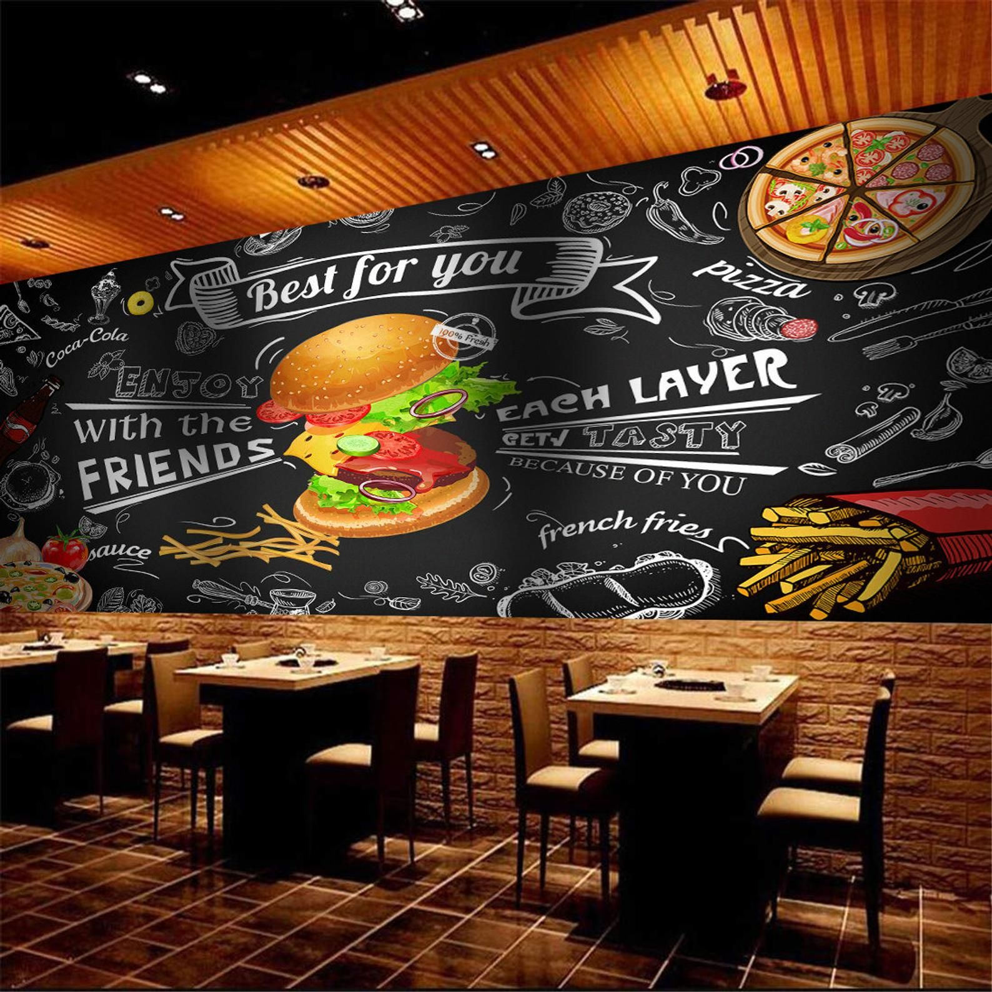
4. No. of restaurants for each rating
The majority of restaurants (3016) are rated 3.9 (out of 5), followed by 4 and 4.1, which are decent ratings. No. of restaurants rated 4 are 2631 and those rated 4.1 are 2468.
There are very few restaurants with very high rating like 4.9 or 4.8.
Also, there are very less number of restaurants that are rated below average.

Slide 11
4. No. of restaurants for each rating

Slide 12
Most of the restaurants at Bangalore are liked by the citizens and hence rated above average.
The competition is at its best, as every restaurant is trying to excel in quality and services to increase the number of customers, and hence enhance profit.

Slide 13
5. Top 10 types of restaurant which have the highest no. of restaurant
We see that, the most number of restaurants are of the type Casual Dining.
People at Bangalore prefer ‘casual dining’ and ‘Quick bites’ more often
Followed by Café and Dessert Parlour.

Slide 14
6. Ten types which have the least number of restaurants
There is only one restaurant of type ‘Dhaba’ followed by ‘food court, casual dining’ which have the least no. of restaurant.
There are also very few bar, microbrewery, club and lounge in the city of Bangalore.

Slide 15
7. Number of restaurants for different average costs
The majority of restaurants in Bangalore have the average cost (for two) 400, followed by 600 and 800.
This means that the competition is very high as far as the less costly restaurants are considered.
The expensive ones in the range of 3000 to 5000 are very few in numbers.

Slide 16
8. Top 10 cuisines that are offered by the maximum number of restaurants
North Indian cuisine is offered by most number of restaurants.
North Indian and Chinese served by more number of restaurants than South Indian. Also, many Indians prefer to eat Chinese.

Slide 17
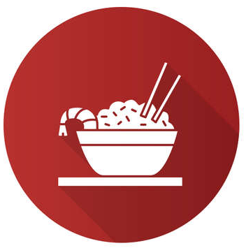
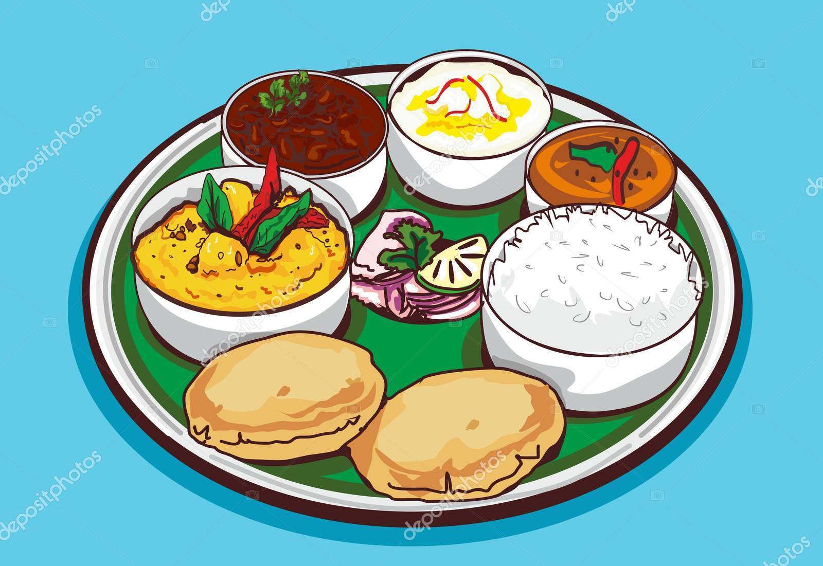

Worth Discussing
Bangalore is situated in South India and yet people there prefer to eat North Indian cuisine.
This can be due to the fact, that people from all sorts of backgrounds reside in Bangalore, hence they like North Indian and Chinese foods more than they do South Indian foods.

Slide 18
9. Top 50 rated
Restaurants
Byg Brewski Brewing Company is the highest rated 4.9 and highest voted around 16000+.
There is a sharp decrease in number of votes when moving from 2nd to 3rd positioned restaurant. no restaurant(or chain of restaurants) is rated 5 out of 5, however we have few who are rated 4.9.
Asia Kitchen by Mainland China, Belgian Waffle and Punjabg Grill cuisines are top rated restaurants with a rating of 4.9 out of 5.

Slide 19
10. Top 50 rated vs 50 least rated restaurants
Top 50 rated
Byg Brewski Brewing Company, Toit, The Black Pearl, Big Pitcher--these are not only highly voted but also highest rated.
The average cost are in the range of 1400-2000 i.e they are a bit expensive.
There are many restaurants that are rated above 4.0, which is a good thing as this indicates that the quality of food is increasing in Bangalore.
50 Least Rated
Fusion Lounge,Decker's Lane,Midnight Hunger Solutions 24/7 and Bageecha are the least rated i.e 2 and least voted around 300-400.
The average cost of Fusion Lounge is 1500 but they do not provide service upto the mark.
The average cost of other leas rated are within 600-800.

Slide 20
10. Top 50 rated vs 50 least rated restaurants
Top 50 rated
Least 50 rated
Name | Rate | Votes | Average cost
Byg Brewski Brewing Company | 4.90 | 16345.00 | 1600.00
SantÃƒÂƒÃ‚ÂƒÃƒÂ‚Ã‚‚Ã‚Â‚ÃƒÂƒÃ‚Â‚ÃƒÂ‚Ã‚Â© Spa Cuisine | 4.90 | 246.00 | 1000.00
Asia Kitchen By Mainland China | 4.90 | 2208.50 | 1500.00
Belgian Waffle Factory | 4.87 | 1225.33 | 400.00
Punjab Grill | 4.85 | 586.00 | 2000.00
Name | Rate | Votes | Average cost
Fusion Lounge | 2.00 | 397.00 | 1500.00
Decker's Lane | 2.10 | 242.50 | 400.00
Midnight Hunger Solutions 24/7 | 2.10 | 253.00 | 500.00
Bageecha | 2.17 | 479.00 | 650.00
Mamma Mexicana | 2.20 | 407.38 | 1000.00

Slide 21
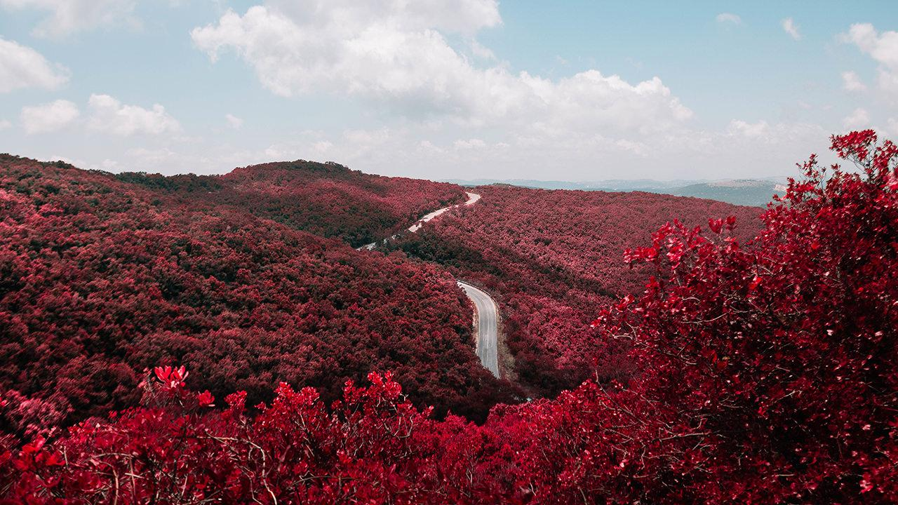
Top rated and voted restaurant
Byg Brewski Brewing Company

Slide 22
Byg Brewski Brewing Company
Rating
This restaurant has outstanding rating, 4.9 out of 5.0 and 16000+ voting.
Meal Type and Cuisine
Microbrewery type of restaurant. Meal type for different branches of the restaurant include Delivery, Dine-out and Drinks & nightlife, this means that Byg Brewski Brewing Company restaurant is one of those strong competitors in these types of meals.
Average Cost
Bit costly, with the average cost(for two people) 1600 but when compared to normal pubs and bars then it seems to be a little cheaper, also the ratings and upvotes show that it is worthy.

Slide 23
Review on Zomato
The place the food the service everything was awesome. I was astonished by the size of this place. No wonder if is the second largest micro brewery in Asia.
Ambiance is top notch. Amazing Ambiance with variety of delicious food with super fast and friendly service person. One of the best restaurants in North Bangalore.The competition is at its best, as every restaurant is trying to excel in quality and services to increase the number of customers, and hence enhance profit.

Slide 24
11. Which city is costlier in terms of food, and which are not with respect to average cost for each city?
The average cost(for two) for restaurants is highest in Church Street(550), followed by Lavelle Road, Residency Road(500) and Brigade Road(500).
For most of the cities the average cost is 400.
Banashankari has the lowest average cost, equal to 300.

Slide 25
12. Which city has the highest number of restaurants with high ratings?
The average rating of restaurants in Brigade Road(3.9), Church Street(3.9) and MG Road(3.9) is highest, followed by Koramangala 4th Block(3.8), and Lavelle Road(3.8)
Electronic City(3.5), however has the lowest number of restaurants with good ratings.
All cities have, on an average, great restaurants.

Slide 26
13. Top 10 dishes liked by the citizens of Bangalore
People at Bangalore love Biryani the most(and why not its so delicious!!), then Waffles followed by Masala Dosa and then Chicken Biryani and then.
Out of these Biryani accounts for the most(30%) liked dish by the people of Bangalore.

Slide 27
14. Top restaurants serving Most liked dish 'Biryani' , along with their ratings and average cost
Name | Bhairaveshwara Military Hotel | eat.fit | Andhra Biryanis | Brundhavana Food Point | Andhra Kitchen | Andhra Ruchulu | Donne Biriyani House | Halo Chef | M.M Restaurant | Bharpur Aahar | Suvarna Sree Food Paradise | Spice Cove - I.V Sanctum | Bhagini Kitchen And Bar | SR Andhra Spicy House
Rate | 4.13 | 4.1 | 4 | 4 | 4 | 4 | 3.9 | 3.9 | 3.9 | 3.9 | 3.9 | 3.8 | 3.8 | 3.8
Avg_cost | 250 | 300 | 700 | 300 | 400 | 400 | 400 | 500 | 600 | 200 | 400 | 750 | 1100 | 800

Slide 28
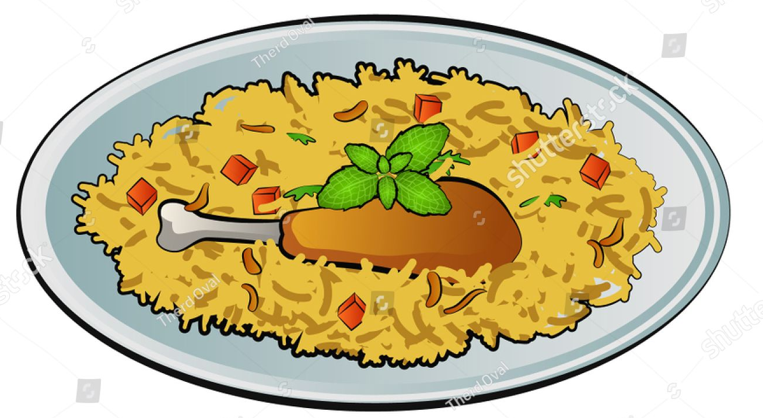
Worth Discussing
Bhairaveshwara Military Hotel with a rating of 4.2 serves the most liked dish ‘Biryani’ to the people of Bangalore.
Then comes eat.fit followed by Andhra Biryani and Andhra Kitchens which provides one of the best qualities biryanis in Bangalore.
All of these restaurants are rate 4.0 and above with an average cost of 250-400 which is quite budget friendly for the people.
That’s the reason why the people of Bangalore love their Biryani the most as it within a affordable range not very expensive.

Slide 29

Conclusion!
The Zomato dataset was analyzed to gain some insights of the food industry and food culture in Bangalore.
We deduce some great results like which city has the most number of restaurants and hence highest number of foodies, we also saw that which city has high number of well-rated restaurants, what all cuisines are mostly preferred by people etc.

Slide 30
Thank You ❤ !!

